Slide 1
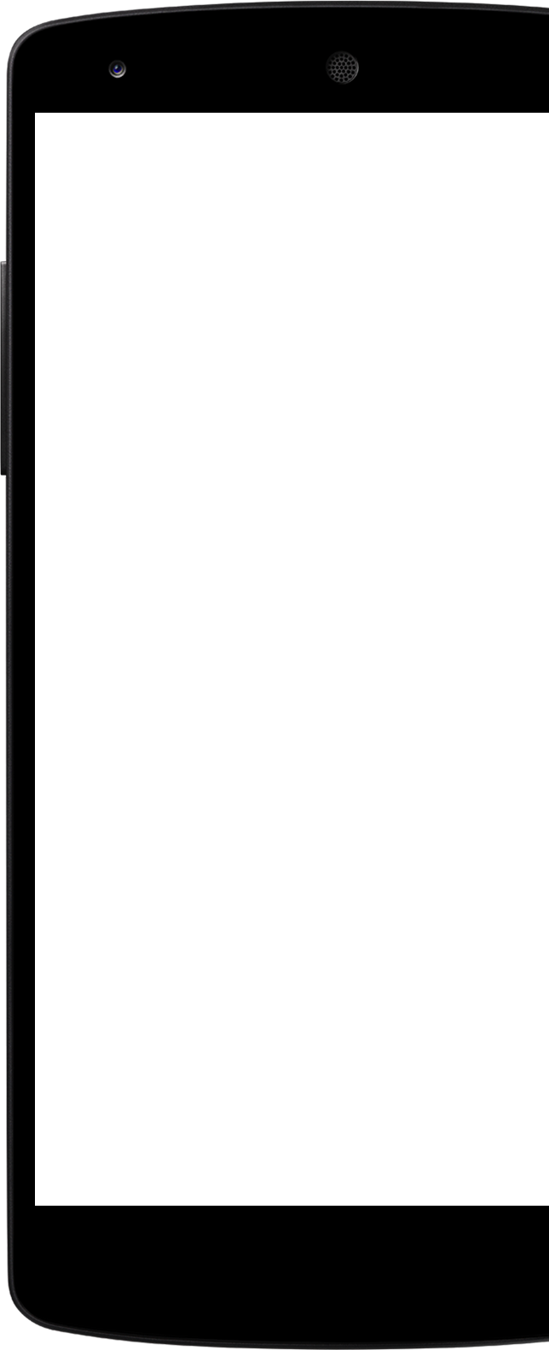

Design of An Automated Alcohol Dispensing System
By: Nathan Bane, Chris Blanks, and Ryan Valente

Slide 2
Outline
Background/Motivation
Design Requirements and Constraints
Planning & Design
Implementation Plan
Implementation
Questions?

Slide 3
Background/Motivation

Slide 4
Introduction
An automated drink making machine that will alleviate wait times in bars, allow customers to select from a wide variety of drinks, and facilitate a good buying experience for the customers.

Slide 5
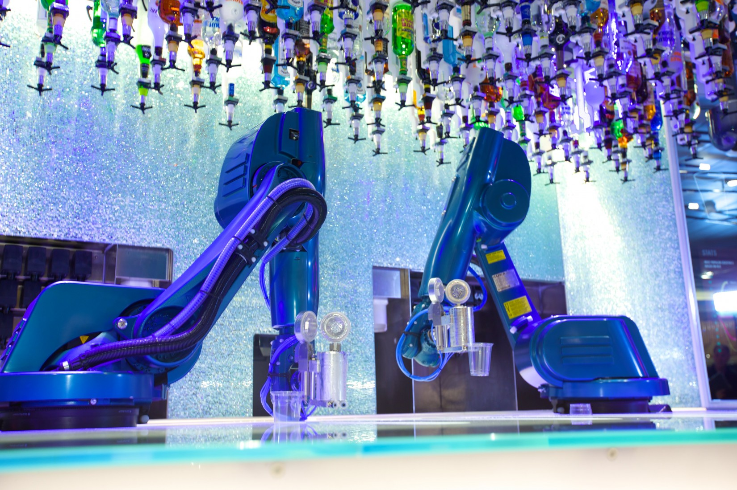
Market solution #1
Royal Caribbean Bar Tending Robot
Robotic arm based design
Suspended drinks with special spouts
Makes drinks that are stirred, shook, and muddle
Two drinks per minute
30 spirits and 21 mixers

Slide 6
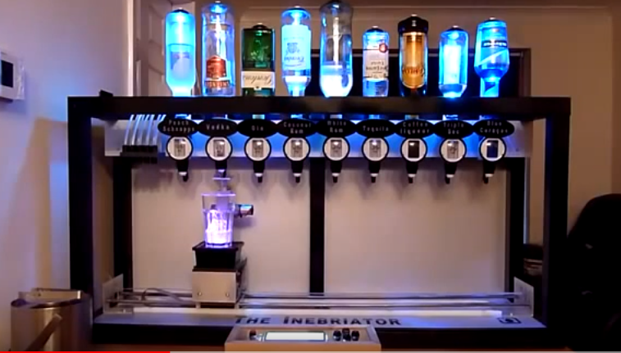
Market solution #2
Random Youtube Drink Making Robot
Linear translation to dispense drinks into cup
Beaumont Spirit Measure device
1 drink at a time
9 drinks available and suspended

Slide 7
Objective
Design an automated cocktailer machine that will offer a more economical solution to reduce wait time for drinks and reduce human error in the drink making process.

Slide 8
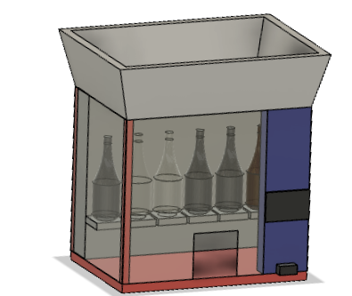
Our Solution
We propose designing a counter-top drink mixing system for bar and home settings that will have the ingredients for at least 10 common drinks. Our solution will include a touchscreen for customers to use and a payment collector. An Android phone application will be developed for managing, monitoring, and changing features on the machine.

Slide 9
Our Drink Menu For This Project
Drink Menu
Naval Gimlet
Long Island Iced Tea
Rum & Coke
Daiquiri
Kamikaze
Cuba Libre
Vodka
Tequila
Screwdriver
Vodka & Cranberry
Inventory to make drinks on menu
Liquors
Gin
Vodka
Light Rum
Tequila
Liqueur
Triple Sec
Mixers
Soda water, Coke
Simple Syrup
Lemon juice, lime juice, orange juice, cranberry juice

Slide 10
Why it’s better than existing solutions
Should be significantly cheaper and smaller than robotic arm solutions
Will be in a temperature controlled environment
Will have a phone application for management, maintenance, and statistical information for the owner
Due to the standard size, it should be easy to integrate into various establishments

Slide 11
Design Requirements and Constraints

Slide 12
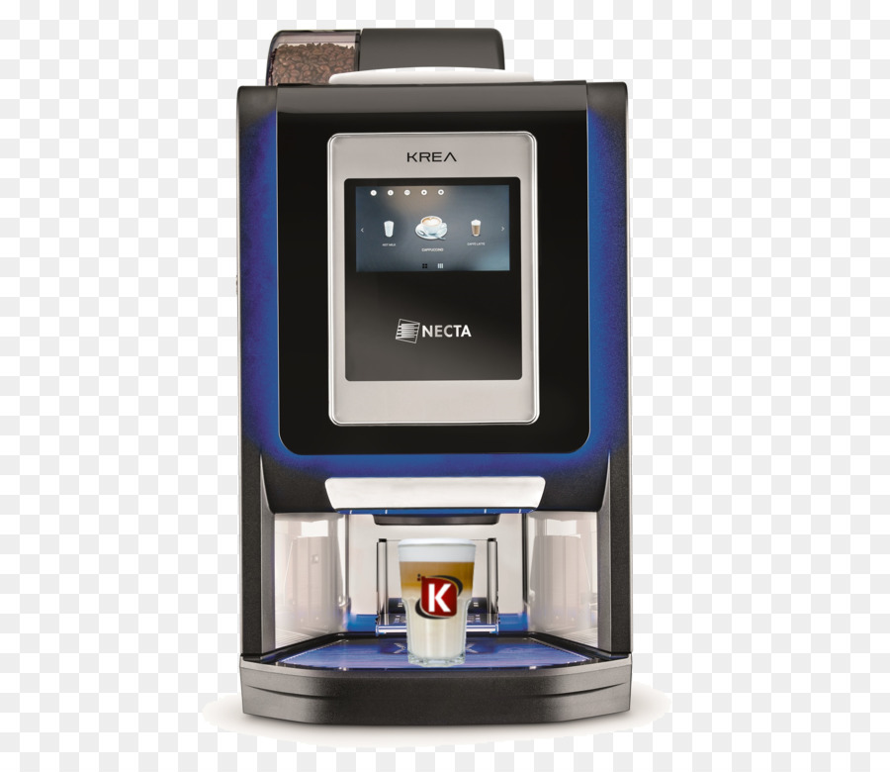
Design Requirements
This machine will fit in a 3.5 x 2.5 x 3 (lwh) ft space and weigh less than 50 lbs.
This machine will check licenses for the legal drinking age if customers are directly interacting with the machine
This machine will be able to serve at least 10 different drinks due to the combinations of 4 liquors, 1 liqueur, and 7 flavoring additives.

Slide 13

Design Requirements (continued)
This machine will be capable of being powered by standard outlets 120/220 V
This machine will offer a touchscreen user interface to order drinks
This machine must securely store profits from customers
The phone application will allow store managers to monitor the machine in real-time and view drink analytics

Slide 14
Design Constraints
The touchscreen interface must be close to eye level of users
Conforms to vending machine food and safety requirements

Slide 15
Planning & Design

Slide 16
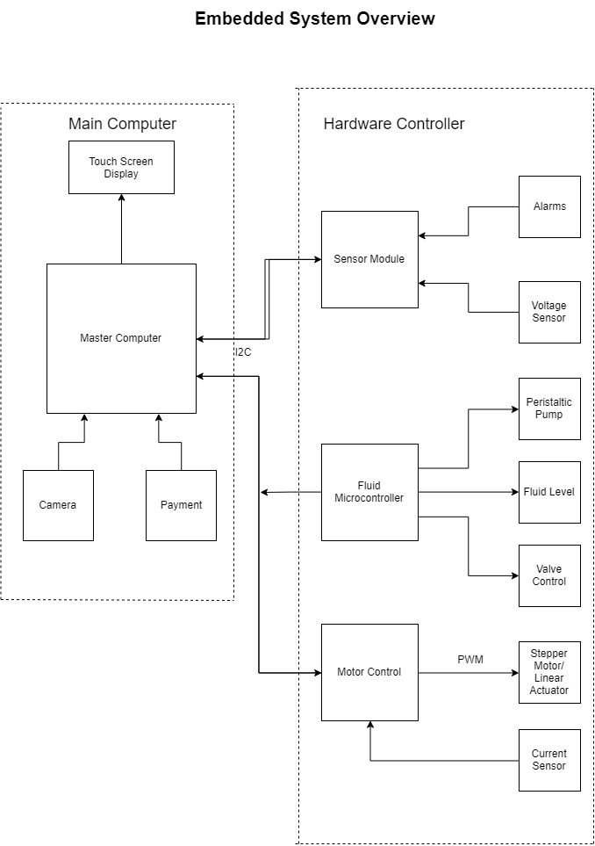
System Description: Embedded Electronics
Hardware Controller
The fluid microcontroller will be used to control the fluid flow
Control and interface valves
Stepper motor driver to control peristaltic pumps
Motor controller to drive the motor used to dispense ice
Sensor module will gather all data necessary to basic operation of the vending machine
Main Computer
Will be connected to the touch screen
Will send commands to the motor controller and fluid microcontroller through the use of I2C
Has to keep a collection of information in the local file system, which will pertain to current inventory and system information
Will use the camera for checking a customer’s license
Will host a ftp server for transferring information to the phone app

Slide 17
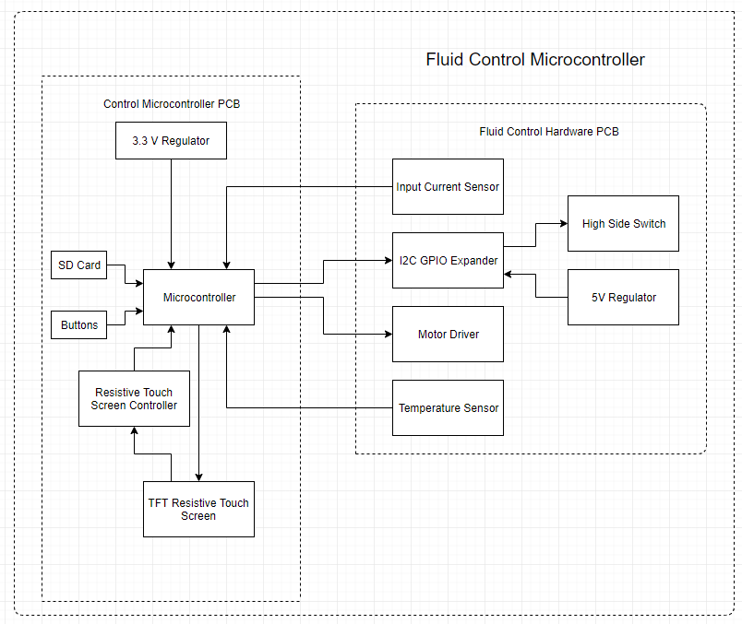
Fluid Microcontroller System Diagram
Control Microcontroller PCB
Separates the microcontroller from the heat generated by the fluid control hardware PCB and helps to isolates ground planes from current loops
Fluid Control Hardware PCB
Interfaces with the valves and pumps

Slide 18
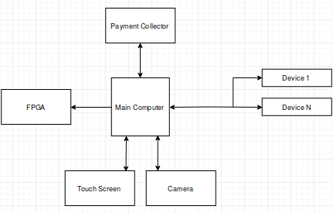
System Description: Main Computer App
The main computer app will do the following:
Provide a drink ordering interface for customers via the touch screen.
Allow employees to update their inventory of drinks while in the GUI.
Directly manage the system information in the local file system of the main computer.
Send commands to peripheral devices in order to manage the state of the full system.

Slide 19
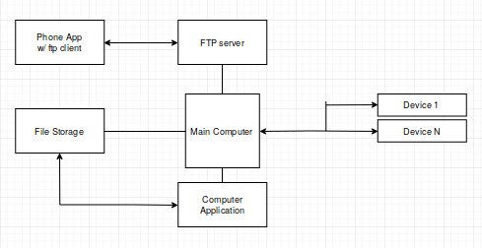
System Description: Phone App
The phone app will have the following:
A main menu containing all of the app’s features
A ftp client built in to access designated files on the main computer (only read access)
A feature to view the amount of drinks bought, stock left, and total sales
An interface to update or reconfigure the system (e.g. switch out drinks, change the entertainment settings)

Slide 20
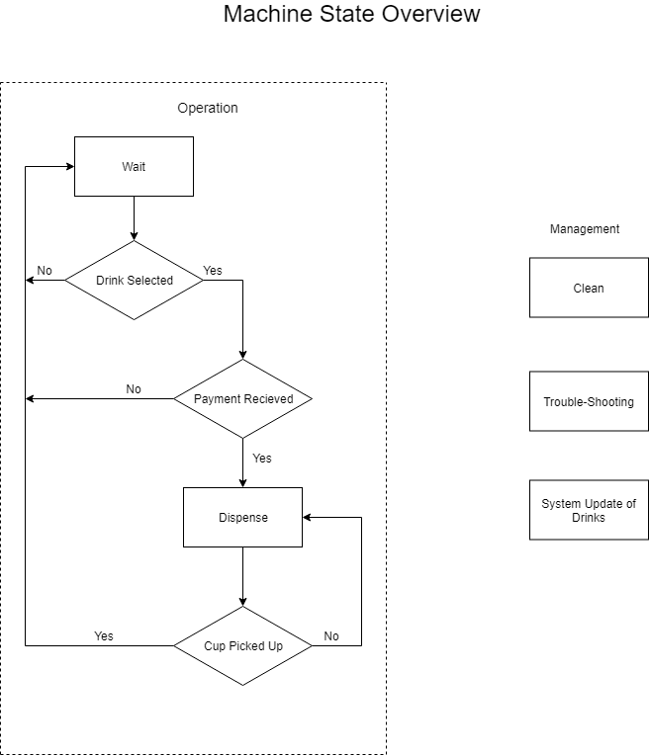
System Functions

Slide 21
Design Approach
Design the board for the embedded system section.
Design a computer application for the main computer.
Write code to interface all the peripherals with the main computer and embedded board.
Design a phone application that can pull system data from the main computer.
Integrate a power supply that will meet the needs of all of the electronics in the whole system.
Develop an image recognition algorithm for checking the age on driver’s licenses.
Add security and entertaining features to the system.

Slide 22
Implementation Plan

Slide 23
Tasks
Design a Valve and Pump Control Board
1.1 Design a High-Side Switch:
1.2 Design a Motor Driver:
1.3 Design a I2C GPIO Expander and Supporting Circuitry
1.4 Design a I2C Thermometer and Supporting Circuitry
1.5 Design Input Power Current Sensor
1.6 Layout components on Printed Circuit Board.
1.7 Order Printed Circuit Board
1.8 Assemble components onto Printed Circuit Board.
1.9 Develop code for the printed circuit board to test assembly.

Slide 24
Tasks (continued)
2. Design Embedded Control Board
2.1 Select Microcontroller and develop supporting circuitry for microcontroller
2.2 Select and design supporting circuitry for I2C eeprom
2.3 Develop circuitry to interface with a resistive touch screen
2.4 Interface switches with microcontroller to manipulate modes of microcontroller
2.5 Layout Printed Circuit Board
2.6 Assemble Components onto Printed Circuit Board
2.7 Code Microcontroller
2.7.a Stand-alone Mode: Code Touch Screen to allow for direct command of the microcontroller
2.7.b Slave Mode: Code microcontroller to receive commands through I2C from the master computer
3. Develop a communication protocol between a shared I2C eeprom, the main computer, and the embedded development board

Slide 25
Tasks (continued)
Create a main computer application
Design a GUI using Python’s Tkinter Library that the customers will use
Develop an efficient way to organize system and drink information in the file storage system
Add in capabilities for communication between the main computer and peripheral devices
Interface the main computer with the embedded boards and peripherals
Develop an algorithm for checking driver’s licenses with the camera
Create a phone application
Design the user interface of the phone app with Android Studio’s SDK
Allow the phone app to access the system information stored on the main computer and acquire relevant data for use within the app
Provide monitoring features (e.g. current stock left, low level of inventory, total sales)
Allow the user to be able to update system information (e.g. drinks currently stored)
Add extra capabilities and entertaining features
Design an LED lightshow to catch the customer’s attention
Use an ultrasonic sensor to trigger the entertaining features whenever a potential customer is close
Build an alarm system to detect forced entry into the internals of the system
Incorporate facial recognition into the main application.

Slide 26
Team Organization
Time | Task | Comments | Responsible Personnel
Fall 2018 Semester
Week 1-4 | N/A | Project proposal and planning | Nathan Bane
Week 4- Week 7 | Task 1 (subtask 1.1,1.2) | Design and draw up a schematic for a high-side switch. Develop circuitry to control a brushed DC Motor .
Week 8- Week 10 | Task 1(subtask 1.3-1.5) | Design and layout circuitry to support an I2C Thermometer, Current Sense Circuitry, and I2C Gpio Expander
Week 11- Week 13 | Task 1(subtask 1.6-1.7) | Layout the components on the Printed Circuit Board and order Printed Circuit Board with parts
Week 13 - End of Semester | Task 1(subtask 1.8-1.9) | Solder components onto the printed circuit board and develop code to test the printed circuit board
Spring 2019 Semester
Week 1-4 | Task 2(subtask 2.1-2.4), Task 3 | Choose a suitable microcontroller and develop supporting circuitry. Develop communication protocol | Nathan Bane & Christopher Blanks
Week 5- Week 8 | Task 2(subtask 2.5-2.6) | Layout printed circuit board, order components , and assemble components onto printed circuit board | Nathan Bane
Week 9 -End of the semester | Task 2(subtask 2.4 ) | Develop Code for Embedded

Slide 27
Team Organization
Time | Task | Comments | Responsible Personnel
Fall 2018 Semester
Week 1-5 | N/A | Project proposal and planning | Chris Blanks
Week 6- Week 11 | Task 4 (subtask 4.1, 4.2, 4.3) | Design and create the main application. Test the inputs and outputs of the system, so that it will interface correctly with the embedded boards and other peripherals.
Week 12- End of the semester | Task 5 (subtask 5.1, 5.2, 5.3) | Design and create the phone application.
Spring 2019 Semester
Week 1-6 | Task 4(subtask 4.4 and 4.5 ) | Finish interfacing and testing the main computer/application with the other systems. Develop an algorithm for checking driver licenses.
Week 7- Week 11 | Task 6 (subtask 6.1 ,6.2, and 6.3) | Design and implement the LED lightshow and alarm system. Incorporate facial recognition into the main application.
Week 11 -End of the semester | Task 5(subtask 5.4 ) | Add extra features to the phone application.

Slide 28
Implementation

Slide 29
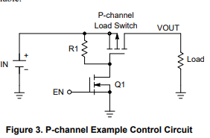
Task 1.1 - High Side Switch
A high-side switch allows devices to be disconnected from its power source.
Device: Solenoid Valve - 12-24V, 5-6 W
High-side switch requirements
Max Current: .5 A * 2 = 1 A
Max Voltage: 24 V
Logic Level (3.3 V) Control
A PMOS pass transistor was chosen over an NMOS transistor because it is simpler to switch due to the NMOS requiring its gate voltage to be greater than the NMOS threshold voltage plus its input voltage.

Slide 30
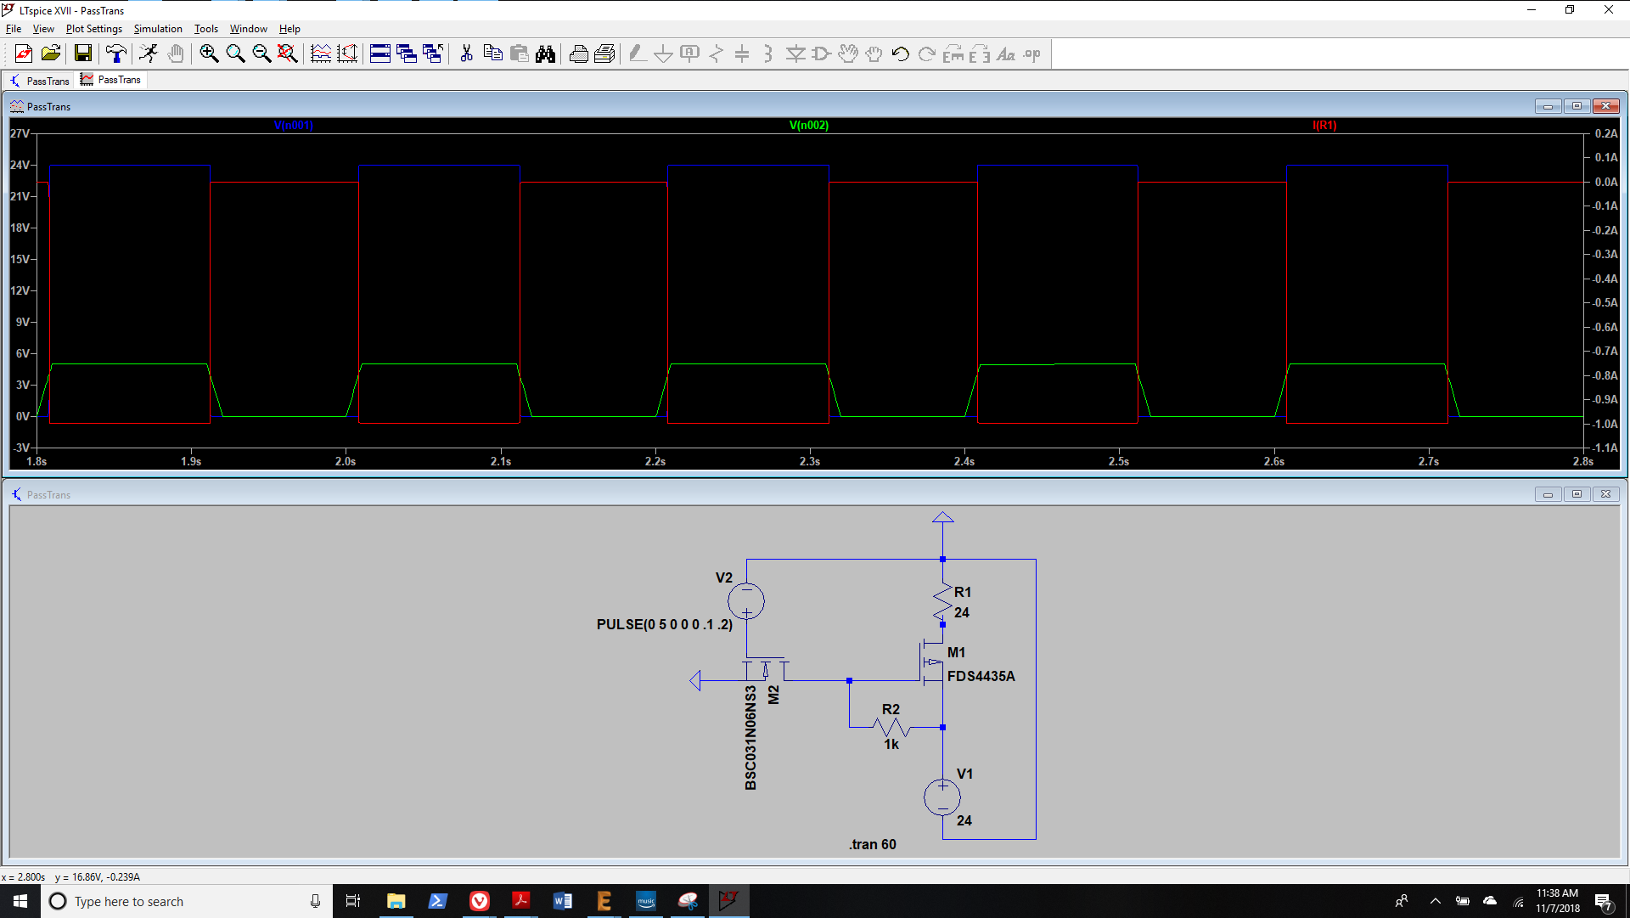
Task 1.1 High Side Switch Simulation

Slide 31
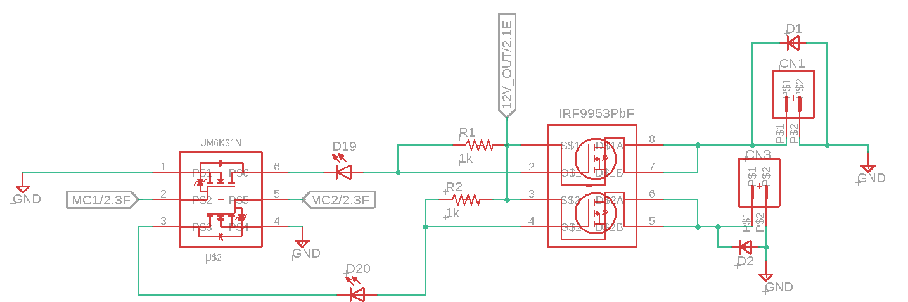
Task 1.1 - High Side Switch Layout
IRF9953PbF - PMOS Power Mosfet
Dual PMOS Package
Vds: -30 V
Vgs: +- 20V
Id: -1.8 A
Rds: .25 Ohm
UM6K31N - NMOS Logic Level Transistor
Dual NMOS Package
Rds: 2.4 Ohm @ 3.3 V VGS

Slide 32
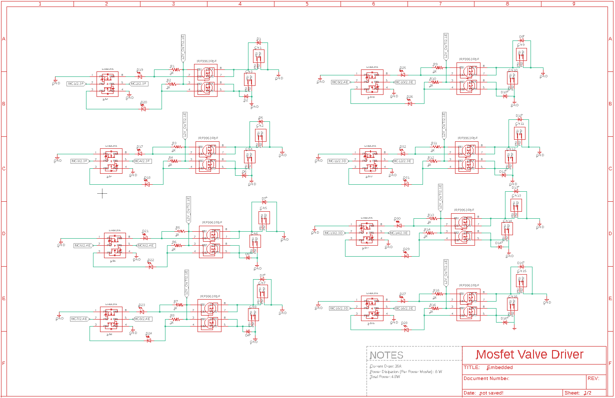
Task 1.1 High Side Switch Full Layout

Slide 33
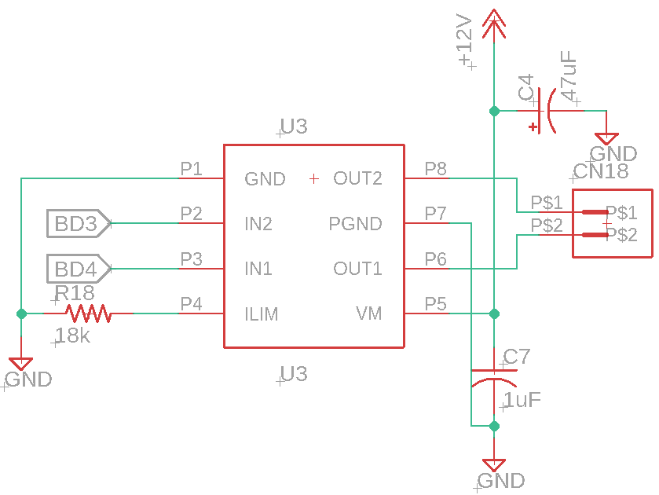
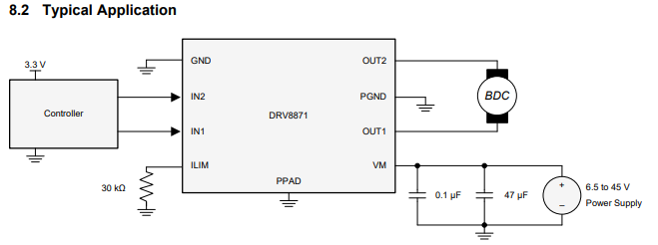
Task 1.2 - Motor Driver
Power Requirements for Peristaltic Pump:
Voltage: 12V
Current: 2.5A
Texas Instruments DRV8871
Voltage: 6.5-45V
Current: 3.6 A
Control: PWM
Integrated Protection Features:
Overcurrent Protection
Thermal Shutdown
Fig 1: Schematic
Fig 2: Data Sheet Configuration

Slide 34
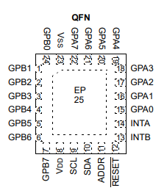
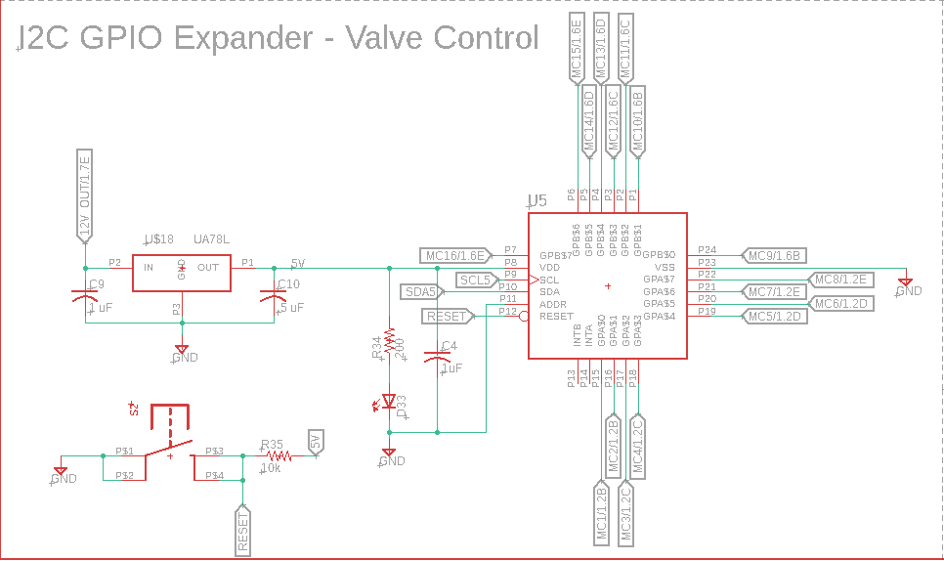
Task 1.3 - I2C GPIO Expander
The purpose of the I2C GPIO Expander is to limit the number of pins needed on the microcontroller to control the valves:
MCP23018:
5.5V 25mA (per pin)/ 400mA Total
I2C Interface Frequencies:
100 kHz
400 kHz
3.4 MHz
16 Pins

Slide 35
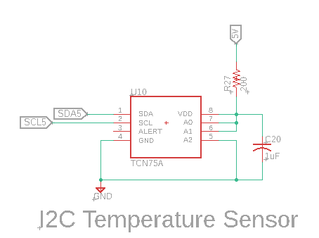
Task 1.4 - I2C Thermometer
The purpose of the I2C GPIO Thermometer is to monitor the overall temperature of the board to determine status of motor drivers
TCN75A:
Temperature Range: -40C - 125C
Accuracy: 0.0625C to .5C
I2C Interface Frequencies:
100 kHz
400 kHz

Slide 36
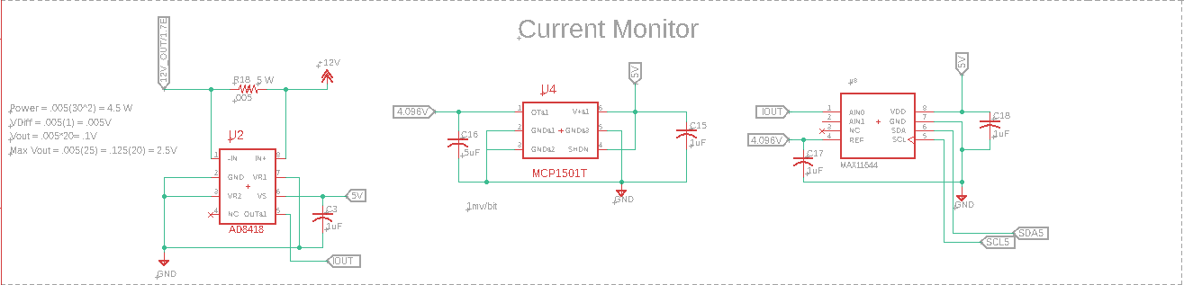
Task 1.5 - Current Sense
It is important to be able to monitor the current draw of the board to determine the function of all components on the board.
Specifications:
Current Range: 200 mA - 80 A
Resolution: 200mA/mV

Slide 37
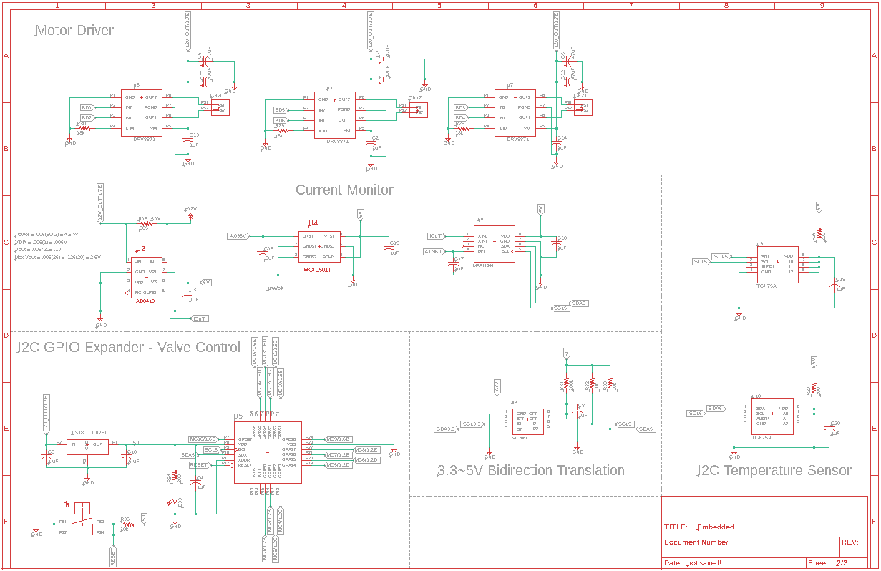
Current Status of Schematic

Slide 38
Task 4, Subtask 4.1
Minimum Required Main Application Features:
Options/help menu bar item for giving information to any user about the machine
Ability to edit configuration file in order to customize main application
Protections against main application window closing and resizing unless in employee mode
Dual-Mode (customer mode and employee/owner mode)
Drink profiles that can be created, edited, and deleted all within the main application
Drinks displayed in main window with buttons to access more information and possibly purchase
Login window for employees and store owner
On-screen keyboard
Ability to order multiple drinks while in employee/owner mode
Encrypted login information stored in local drive
Dual-Mode controlled by the state of a physical switch
Key:
= Done
= In-Progress

Slide 39
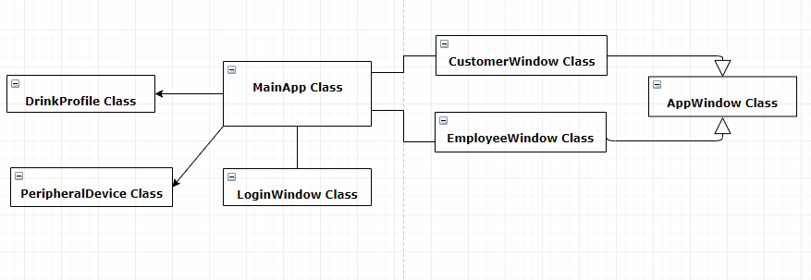
Task 4, Subtask 4.1
Class Structure For Main Application

Slide 40
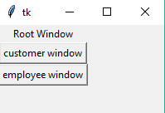
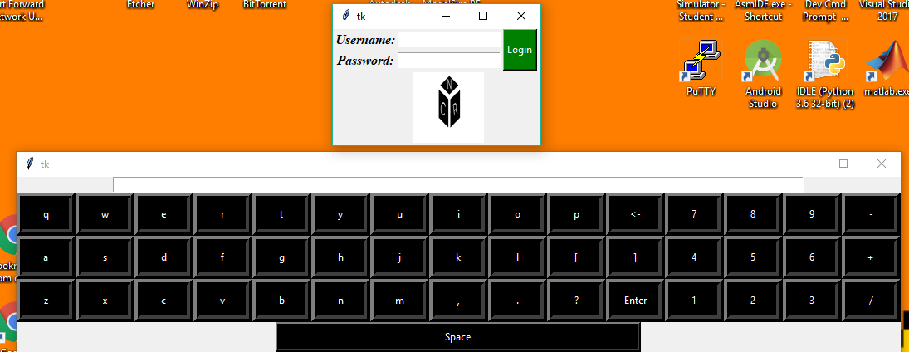
Task 4, Subtask 4.1
Login Window with Onscreen Keyboard

Slide 41
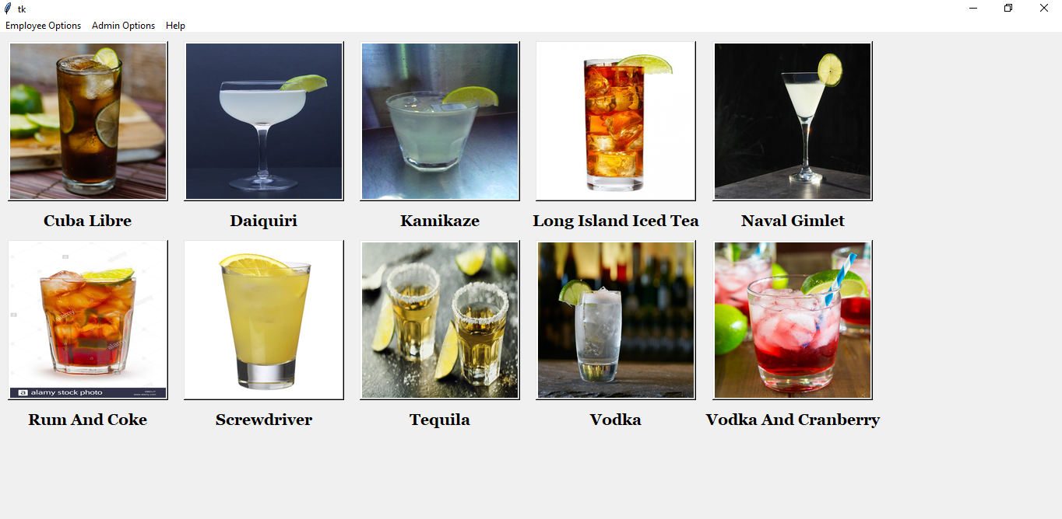
Task 4, Subtask 4.1
Main Employee Window

Slide 42
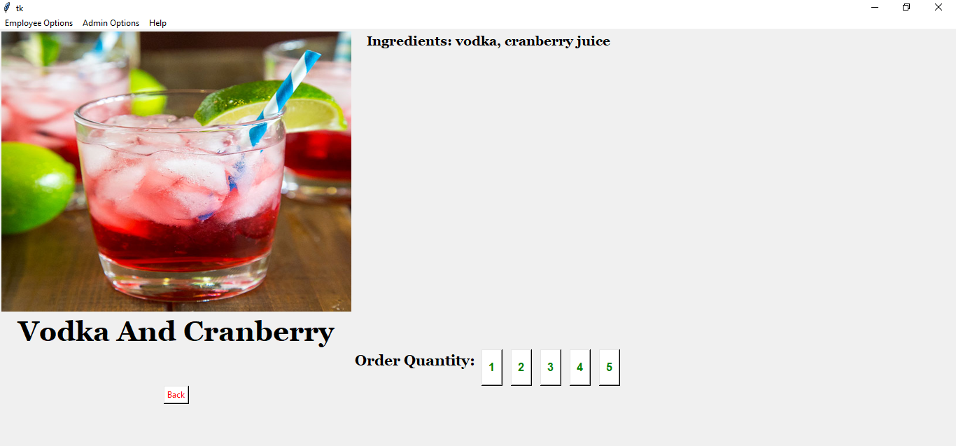
Task 4, Subtask 4.1
Drink Profile In Employee Window

Slide 43
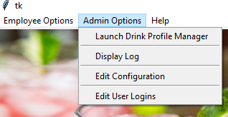
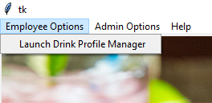
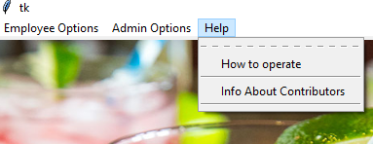
Task 4, Subtask 4.1
Dropdown Menu Options In Employee Window

Slide 44
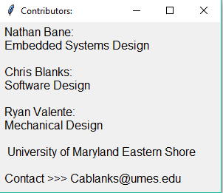
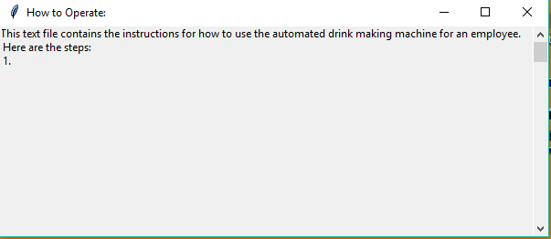
Task 4, Subtask 4.1
Operation Instructions for Employee
Contributor and Contact Info Window

Slide 45
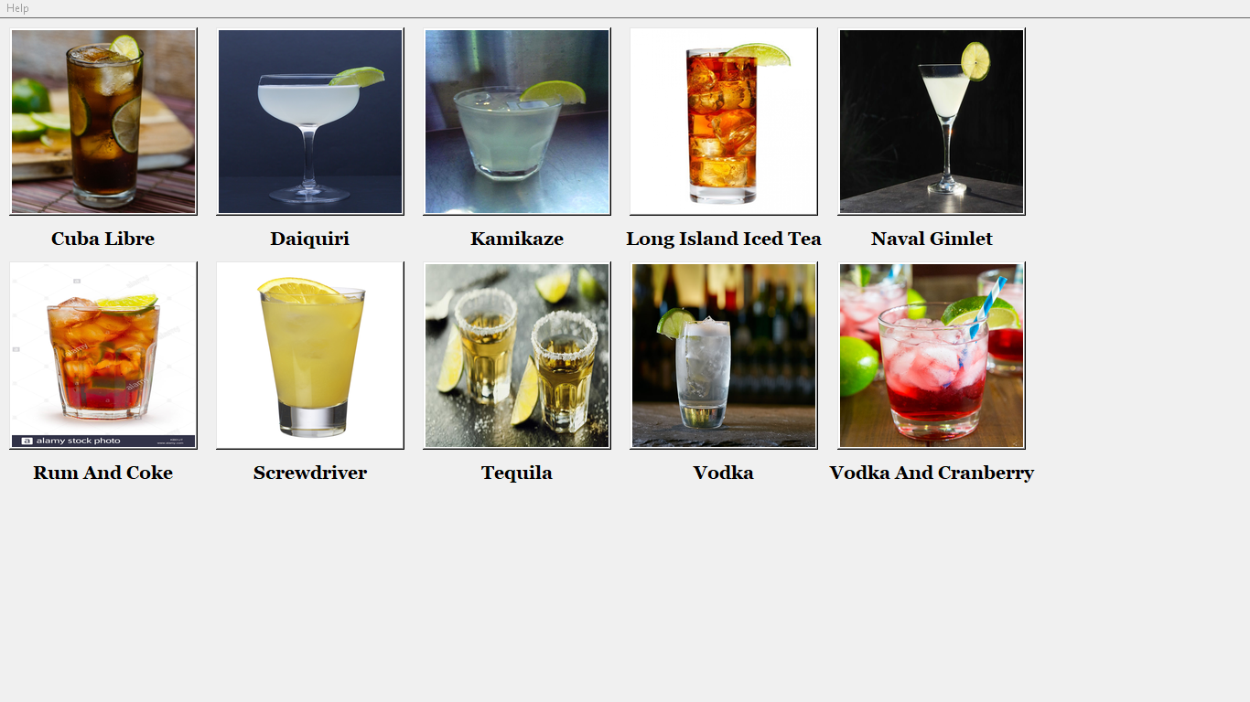
Task 4, Subtask 4.1
Main Customer Window

Slide 46
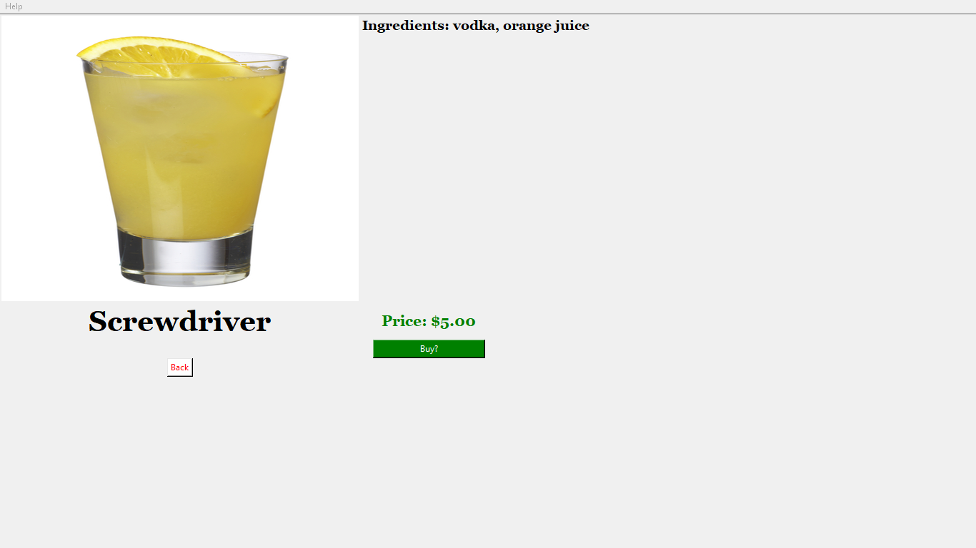
Task 4, Subtask 4.1
Drink Profile in Customer Window

Slide 47
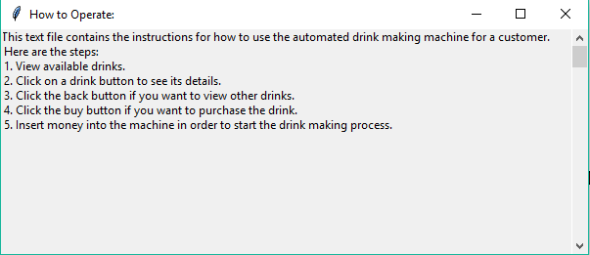
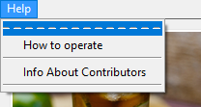
Task 4, Subtask 4.1
Operation Instructions for Customer
Help Menu Bar for Customers

Slide 48
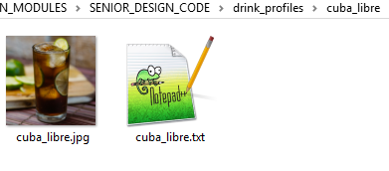
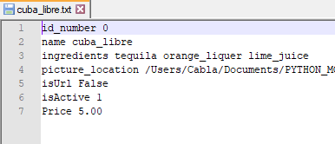
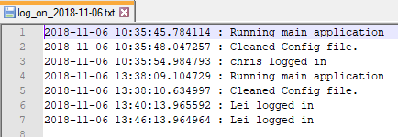
Task 4, Subtask 4.2
Created a file system format that will allow easy updating of inventory from within the main application and eventually the phone application
Created a method that will log main application information in a new file for each day (e.g. start of program, users who logged in)
Created a configuration file that will keep a current record of system information
Created a csv file for storing inventory quantities and analytics that will be referenced by the main app and phone app

Slide 49
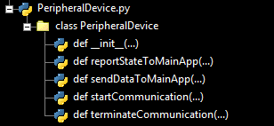
Task 4, Subtask 4.3
The PeripheralDevice class defines a standard communication interface between peripheral devices (e.g. the camera, bill collector) and the main application
Allows for easy extensibility for any new peripheral device to the system
Individual devices will inherit attributes and methods from the PeripheralDevice base class and build upon them for their specific implementations

Slide 50
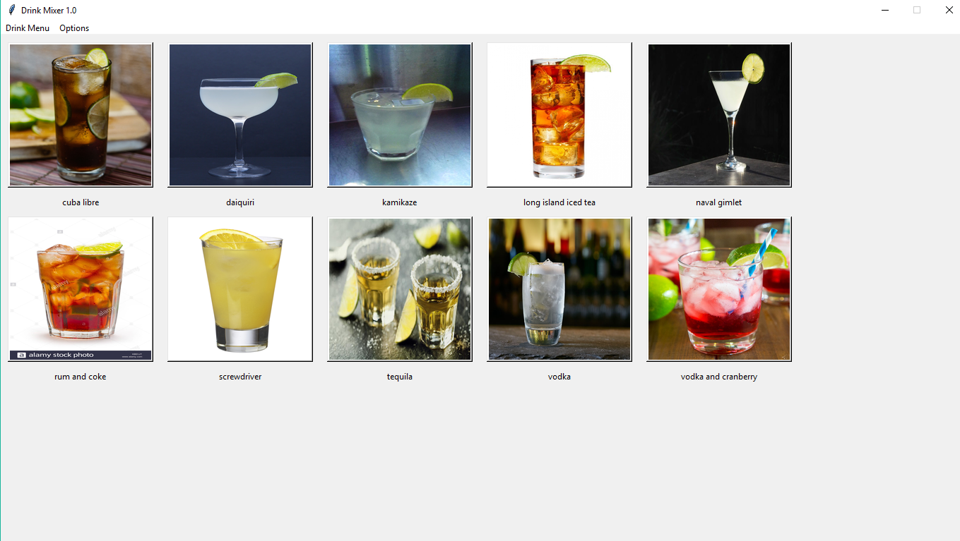
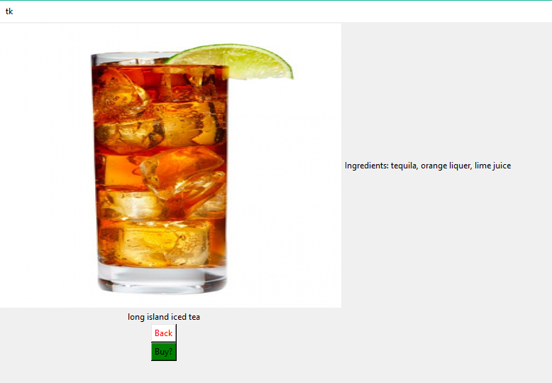
Task 4, Subtask 4.1
Able to load a variable size of drink profiles from the local file system and display their names and autoscaled images in the main window
The images are embedded into buttons, so clicking on them leads to a full drink profile page
Displays ingredients
Larger image
Offers a back button to return to the initial screen
Designed a basic version of the customer screen
Will require some modifications once 10” touchscreen is acquired

Slide 51
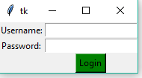
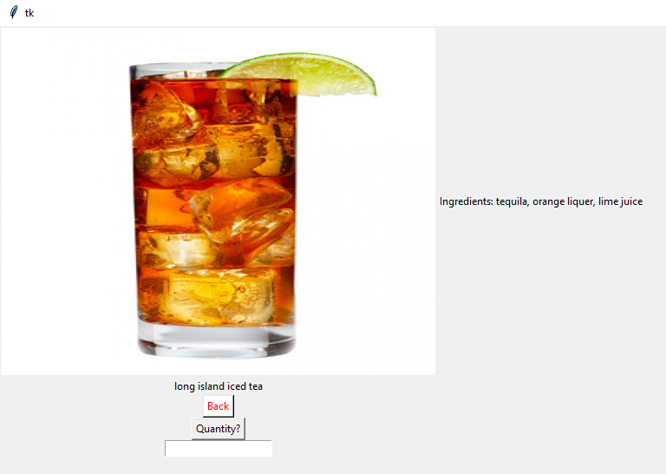
Task 4, Subtask 4.1
Created a Login Window class that handles the login process for employees/owners
Simple username and password
Login button
Locked file of login credentials that the main application references whenever a user tries to login
Will encrypt stored passwords
Redirects to employee window if login is successful
The login window will eventually be triggered by the state of a GPIO pin on the main computer
Redirects to the customer window if the user fails more than 3 times

Slide 52
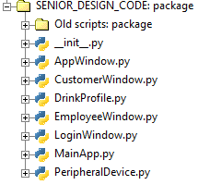
Task 4, Subtask 4.1
Main Scripts:
AppWindow.py defines the base class that the customer and employee windows inherit from
CustomerWindow.py defines features for the customer window
EmployeeWindow.py defines features for the employee window
DrinkProfile.py defines the drink objects that are used within the main application
LoginWindow.py defines the the features of the login window
MainApp.py defines the main application that acts as the controller for the GUI and the overall system
PeripheralDevice.py defines the base class that all peripheral devices will inherit from

Slide 53
Minimum Required Main Application Features:
Key:
= Done
= In-Progress
Dual-Mode (customer mode and employee/owner mode)
Drink profiles that can be created, edited, and deleted all within the main application
Drinks displayed in main window with buttons to access more information and possibly purchase
Login window for employees and store owner
On-screen keyboard
Ability to order multiple drinks while in employee/owner mode
Encrypted login information stored in local drive
Dual-Mode controlled by the state of a physical switch
Options/help menu bar item for giving information to any user about the machine
Ability to send low level commands via serial communication
Change the state of the main application depending on GPIO inputs from peripherals (e.g. bill collector)
Ability to edit configuration file in order to customize main application
Protections against main application window closing and resizing unless in employee mode
Progress bars for the drink making process
Embedded live video stream during wait mode

Slide 54
Questions?

Slide 55
References
http://www.royalcaribbean.com/connect/robot-bartenders-shake-things-up-at-sea/
https://www.youtube.com/watch?v=fAh6hQRKBU8

